Slide 1

CSE- 104
Structured Programming Lab
Lab : 1 Overview
Fahad Ahmed
Lecturer, Dept. of CSE
E-mail: fahadahmed@uap-bd.edu

Slide 2
Structured Programming
What is Structured Programming?
Why we use ?
What is the disadvantage of Structured Programming?

Slide 3

Remembering : CSE 101

Slide 4
C Data Types
Type | Size (bytes) | Format Specifier
int | at least 2, usually 4 | %d, %i
char | 1 | %c
float | 4 | %f
double | 8 | %lf
short int | 2 usually | %hd
unsigned int | at least 2, usually 4 | %u
long int | at least 4, usually 8 | %ld, %li
long long int | at least 8 | %lld, %lli
unsigned long int | at least 4 | %lu
unsigned long long int | at least 8 | %llu
signed char | 1 | %c
unsigned char | 1 | %c
long double | at least 10, usually 12 or 16 | %Lf

Slide 5
C Data Types
signed and unsigned ??
unsigned int x;
int y;
??

Slide 6
C Data Types
unsigned int x;
int y;
Here, the variable x can hold only zero and positive values because we have used the unsigned modifier.
Considering the size of int is 4 bytes, variable y can hold values from -2³¹ to 2³¹-1, whereas variable x can hold values from 0 to 2³²-1.

Slide 7
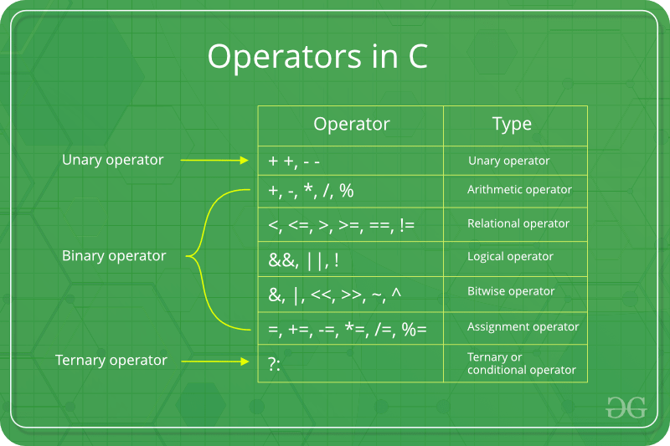
Operators

Slide 8
Operators
#include <stdio.h>
int main()
{
int i = (1, 2, 5,4);
printf("%d", i);
return 0;
}

Slide 9
Operators
Output:
88
Explanation:
The bracket operator has higher precedence than assignment operator. The expression within bracket operator is evaluated from left to right
but it is always the result of the last expression which gets assigned.
#include <stdio.h>
int main()
{
int i = (1, 2, 3, 88);
printf("%d", i);
return 0;
}

Slide 10
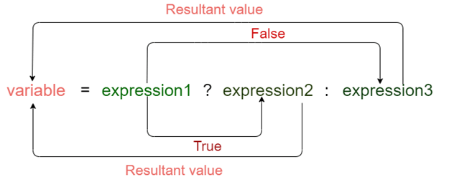
Conditional or Ternary Operator (?:)
Res= 5>99 ? 1 : 0

Slide 11
Conditional or Ternary Operator (?:)
Syntax:
The conditional operator is of the form
variable = Expression1 ? Expression2 : Expression3
It can be visualized into if-else statement as:
if(Expression1)
{
variable = Expression2;
}
else
{
variable = Expression3;
}

Slide 12
Conditional or Ternary Operator (?:)
#include<stdio.h>
int main()
{
printf("%d", 10 ? (0 ? 5 : 1) : 12);
}

Slide 13
Conditional or Ternary Operator (?:)
#include<stdio.h>
int main()
{
printf("%d", 10?0?5:1:12);
}
Output: 1

Slide 14
++ and -- operator as prefix and postfix
a = 5
++a; // a becomes 6
a++; // a becomes 7
--a; // a becomes 6
a--; // a becomes 5

Slide 15
++ and -- operator as prefix and postfix
int i=10;
printf("%d,%d,%d,%d",i++,++i,i++,++i);

Slide 16
++ and -- operator as prefix and postfix
int i=10;
printf("%d,%d,%d,%d",i++, ++i, i++, ++i);
13 14 11 14
Pre-increment operators work like, they first update, and then, we get to use the value.
Post-increment does it like, we get to use the value first and then update.
Again, the operands get ‘evaluated’ right-to-left.
So, the first expression that we get is ++i. That increments the value of i to 11. But since, this is a pre-increment, we won’t use the value, until the whole bunch of things get evaluated. So, we need to put in the value of i as the 4th argument, which will happen at the very end.
Then, we have an i++, so, we use the value we have in hand, which is 11. Hence the value 11 as the third one. We, of course do update i to 12.
Then, we have a ++i again, so we just increment the value of i to 13.
Then, we have an i++, and we use the value 13, to get the first number as 13. The remaining update takes i to 14.

Slide 17
++ and -- operator as prefix and postfix
int i=10;
printf("%d,%d,%d,%d",i++,++i,i++,++i);
Now, since everything that can be done has been done, we need to plug in the values of i wherever they were required (due to the pre-increment). So, we have two 14s, at the second and fourth place.
That gives us the answer 13, 14, 11, 14.

Slide 18

Lab Task
Given two integer variables, X and Y, swap the contents of the variables Without Using Temporary Variables . (don’t just print Y, X)
Input
Two integers, X and Y
Output
One line containing two integers X and Y with their contents swapped followed by a new line.
Check sample output.

Slide 19
Lab Task
#include <stdio.h>
int main()
{
double a, b;
printf("Enter a: "); scanf("%lf", &a);
printf("Enter b: "); scanf("%lf", &b);
// Swapping
// a = (initial_a - initial_b)
a = a - b;
// b = (initial_a - initial_b) + initial_b = initial_a
b = a + b;
// a = initial_a - (initial_a - initial_b) = initial_b
a = b - a;
printf("After swapping, a = %.2lf\n", a);
printf("After swapping, b = %.2lf", b);
return 0;
}

Slide 20
Lab Task
#include <stdio.h>
int main()
{
int x = 10, y = 5;
// Code to swap 'x' and 'y'
x = x + y; // x now becomes 15
y = x - y; // y becomes 10
x = x - y; // x becomes 5
printf("After Swapping: x = %d, y = %d", x, y);
return 0;
}

Slide 21
Lab Task
Swap three variables without using temporary variable
Input : a = 10, b = 20 and c = 30
Output : a = 30, b = 10 and c = 20

Slide 22
Lab Task
#include <stdio.h>
int main()
{
int a = 10, b = 20, c = 30;
a = a + b + c; // (a = 60)
// After this, b has value of a
b = a - (b+c); // (b = 60 – (20+30) =10)
// After this, c has value of b
c = a - (b+c); // (c = 60 – (10 + 30) = 20)
// After this, a has value of c
a = a - (b+c); //(a = 60 – (10 + 20) = 30)
printf("After Swapping: a = %d, b = %d, c = %d", a,b,c);
return 0;
}

Slide 23
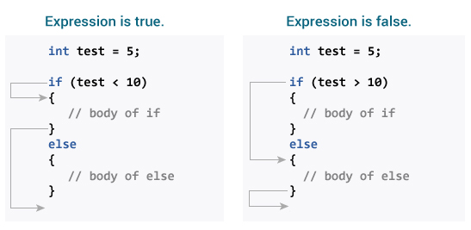
Flow Control

Slide 24
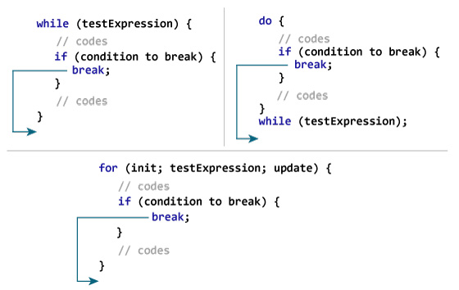
Flow Control

Slide 25
Flow Control
Write a C Program to Reverse a Number (integer)
Input: 123456 (max 8)
Output: 654321

Slide 26
Flow Control
#include <stdio.h>
int main() {
int n, rev = 0, remainder;
printf("Enter an integer: ");
scanf("%d", &n);
while (n != 0) {
remainder = n % 10;
rev = rev * 10 + remainder;
n /= 10;
}
printf("Reversed number = %d", rev);
return 0;
}

Slide 27
Flow Control : Home Task
Nested Loop (Grid / Pattern)
+
Small Test (10)
Problem link: https://www.w3resource.com/cpp-exercises/for-loop/index.php#EDITOR

Slide 28

Thanks to All

